Slide 1
Employee Data Analysis using Excel
STUDENT NAME:Balaji.M
REGISTER NO: 312220278
DEPARTMENT: III – B.Com Computer Application (Commerce)
COLLEGE: Jeppiaar College of Arts and Science

Slide 2
PROJECT TITLE
Employee Salary Analysis using Excel

Slide 3

AGENDA
Project Overview
End Users
Our Solution and Proposition
Dataset Description
Modelling Approach
Results and Discussion
Conclusion
Problem Statement
3/21/2024 Annual Review

Slide 4

PROBLEM STATEMENT
The HR department at XYZ Corporation would want to carry out an analysis of salary data for the employees in order to develop trends and patterns and most likely even disparities in compensation. Data includes:
Employee ID
Salary
Department
Job Title
Gender
Age
Years of Service
Education Level

Slide 5
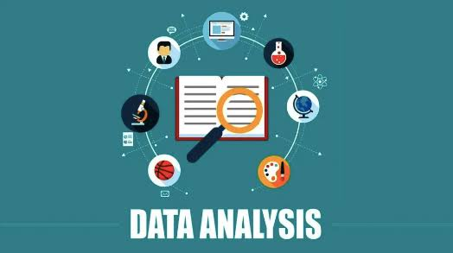
PROJECT OVERVIEW
- Title: Employee Salary Data Analysis
- Objective: This tries to analyze the trend, pattern,
and any disparities in employee compensation.
- Dataset: Employee ID, Salary, Department, Job Title, Gender, Age, Years of Service, Education Level

Slide 6


WHO ARE THE END USERS?
1. HR Manager
2. Compensation Analyst
3. Business Leaders
4. Finance Team
5. Department Managers
6. Diversity, Equity, and Inclusion (DEI) Team
7. External Auditors or Consultants

Slide 7
OUR SOLUTION AND ITS VALUE PROPOSITION
- Insightful Information: Obtain valid and accurate salary data analysis to help compensate a decision.
- Identify disparities: Recognize that there are chances of bias in the process of compensation and, hence, provide equity in pay practices.
Data-Informed Decisions: This would enable salaries to be planned in informed decisions, budgeting to be accurately done, and compensation adjustments made with confidence.
- Cost Optimization: Provide value engineering in salary expenditure and identify areas where costs may be saved.

Slide 8
Dataset Description
Employee salary dataset – Kaggle.com
Variables :
Employee Id = <int>Numerical Values
Name = <int>Text Values
Salary = <int>Numerical Values
Job Title = <int>Text Values
Department = <int>Text Values
Gender = <fct> Text Values(Female or Male)
Experience = <int>Numerical Values
Location = <int>Text Values

Slide 9

THE "WOW" IN OUR SOLUTION
W_ (Winners):- Fair salaries- Transparent pay structure- Performance-based raises
O_ (Opportunities):- Improved retention- Increased productivity- Better talent attraction
W_ (Woes):- Potential increased costs- Implementation challenges- Employee resistance
3/21/2024 Annual Review
9

Slide 10
MODELLING
Dataset collection - Employee Salary Dataset
Dataset Preparation - Clearing Blanks, Filtering and removing Blank data in the database.
Using VLOOKUP formula to find an Employees salary.
Insert Pivot Table to summarize the dataset on employee salary based on gender, trends and jab title.
Data visualization using Bar Chart and Pie chart to represent the turnover by gender.
Final Report
10

Slide 11
RESULTS
BAR CHART VISUALISATION
11

Slide 12
RESULTS
PIE CHART VISUALISATION

Slide 13
conclusion
In conclusion, our analysis reveals key insights into employee trends, including [briefly mention to enhance employee experience and drive business growth. By acting on these insights, we can improve retention, productivity, and overall success."

